Slide 1
Fort Bend ISD General SHAC Meeting Theme: Mental Health Wednesday, September 4, 2024

Slide 2
Welcome & Mindful Moment
Catalina Flores-Rau
SHAC Chair

Slide 3
SHAC Executive Team Introductions & SHAC Overview

Slide 9
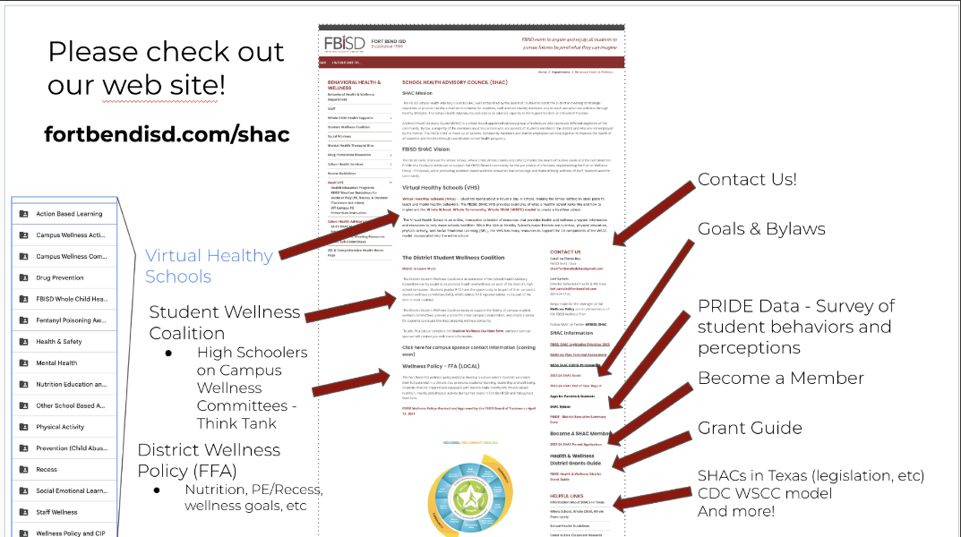

Slide 10
Subcommittee Leads (FBISD & Parent) Introductions

Slide 12
Kayla Luedke & Davina Myles
FBISD Lead Social Workers
Rachel McCune
FBISD Coordinator of School Counseling

Slide 13
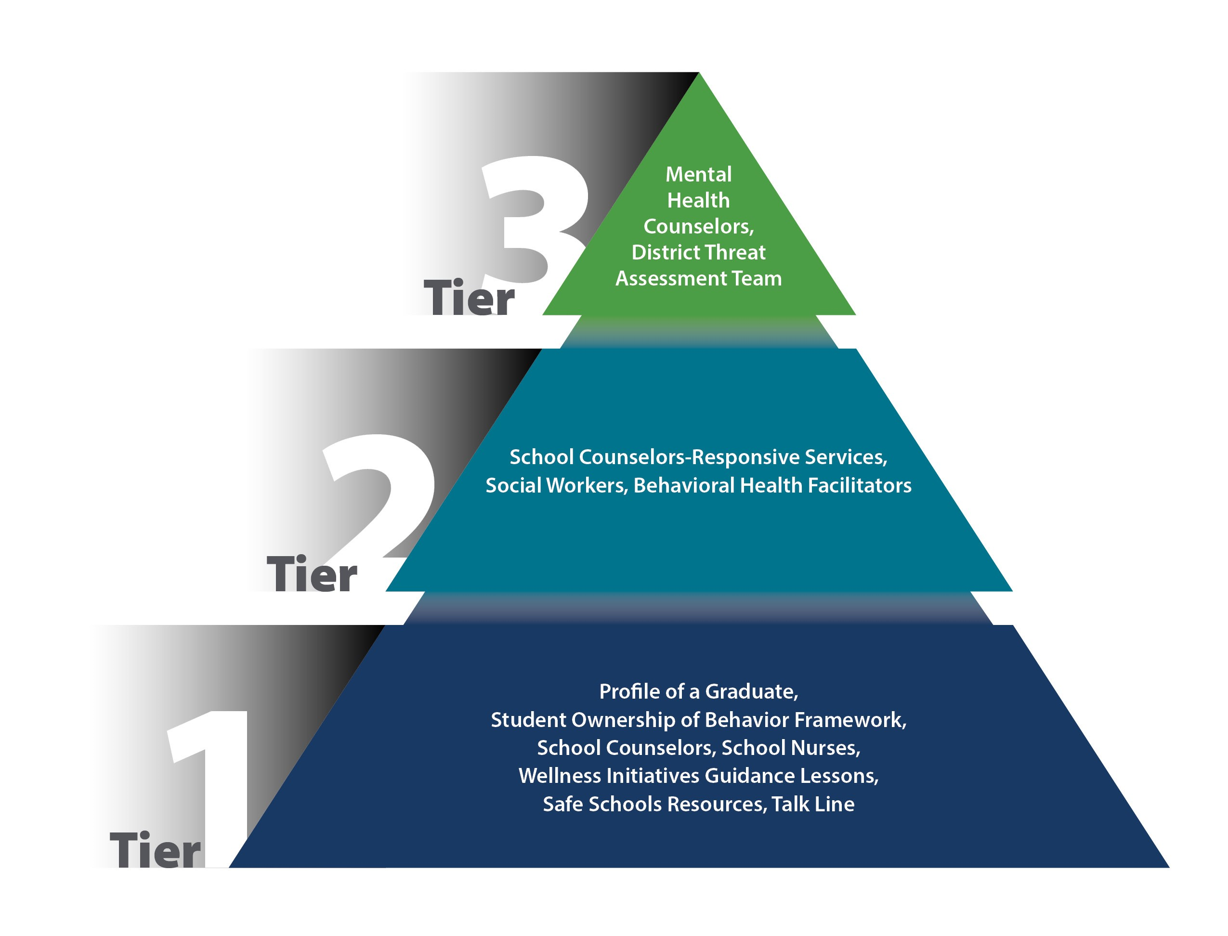
Multi-Tier Systems of Support

Slide 14
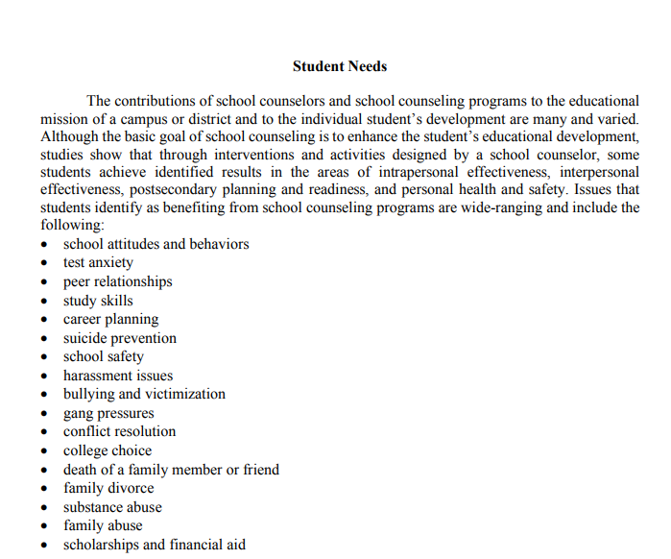
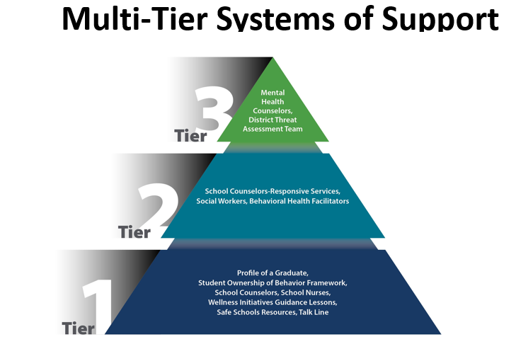

Slide 15
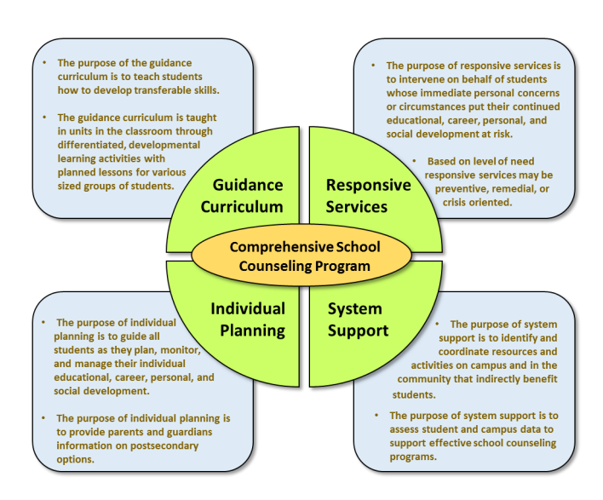

Slide 16
Examples of Tier 1 Interventions
(Counselors and Behavior facilitators)
Classroom guidance lessons
Large group guidance lessons
Classroom Management Support
Behavioral Health Facilitators (previously PBIS) supports classroom teachers
SEL lessons (Attributes of Profile of a Graduate)

Slide 17
Examples of Tier 2 Interventions
(School Counselors, Social Workers, Behavior facilitators)
Individual Guidance Support (at least 3 visits)
Group Guidance Support (at least 3 groups)
Community resource referral
Daily/Weekly Check-ins with counselor (at least 4 weeks)
Behavioral Intervention Plan Development
Behavioral Data Collected
Social Work involvement (individual and/or group; at least 3 visits)
Behavior Health Facilitator Involvement
Restorative Chat/Circle
Mentoring
PALS/Peer Mentoring
Referral to Fort Bend Regional (if applicable)
Collaboration with physician and/or community mental health provider
Parent Conference/Involvement
Home Visit
Collaboration with the SPED department (if applicable)
Consultation with the Probation Officer/Truancy Officer (if applicable)
Consultation with the CPS Caseworker (if applicable)

Slide 18
Examples of Tier 3 Interventions
This is intensive and individualized therapy
Crisis Intervention (i.e. Texana)
Referral to District Mental Health Therapist: 6 District LPC/LCSWs
Referral to campus Community Mental Health Partner (Clearhope, Depelchin, Invocare IMPACT, Safe Place Counseling and TCHATT/ASUD)

Slide 19
Referral Process for Tier III MH Services
Parent must submit a Permission to Refer for Mental Health Services
Once the district receives the consent, the student’s counselor is notified. Only then can a mental health referral be initiated to a District Mental Health Partner.​
Once the Partner receives the referral, they reach out to the family to complete an intake packet that includes a second consent that needs to be in place for services to be initiated.

Slide 20
FBISD Mental Health Therapists
FBISD Mental Health Therapists (6)
Short term counseling (10-12 sessions)​ Face to face at campus/ some virtual sessions when appropriate​ Family has NO Insurance/Medicaid and Student is NOT a Victim of crime Limited resources MHTs are FBISD employees Support all campuses​ (serve 13-14 campuses each) **Parent Permission is required prior to making a referral

Slide 21
Community Partners: All 80 campuses
Texas Child Health Access Through Telemedicine
TCHATT
2 Campuses for Teletherapy
District wide Psychiatry
8 Campuses
46 Campuses
11 Campuses
15 Campuses

Slide 22
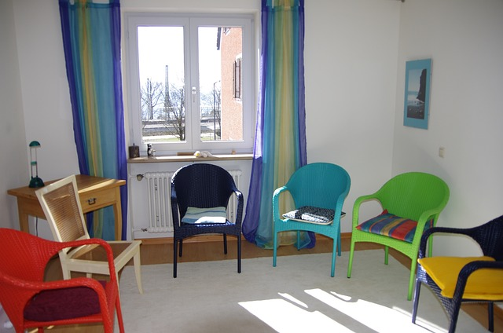
Billing Options
Victims of Crime Act (VOCA) Grant: the district must apply for this every year.
Insurance
Private Pay
No pay
The district works hard to remove barriers to access mental health services for students
This Photo by Unknown Author is licensed under CC BY-SA

Slide 23
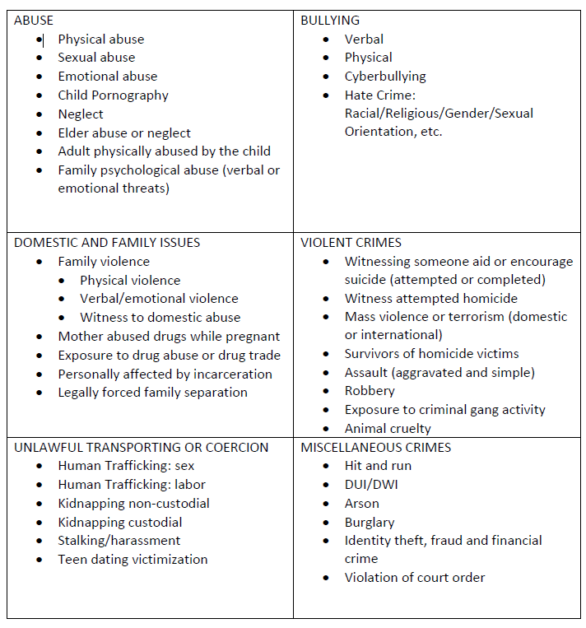
Types of Victimization
Primary: The student themselves has witnessed or experienced any of the following.
Secondary: Any member of the household/family has witnessed or experienced any of the following, which has impacted the student.

Slide 24
470 Students Received Tier III Mental Health Services through the district
4,204 Clinical sessions were conducted at no cost to the parent. Covered either by the VOCA grant or district mental health therapists
Services were provided by 19 therapists

Slide 25
Subhead
Students cannot be referred for mental health services without written parent permission form on file. (Permission to refer for Tier III mental health services)
Therapists cannot see students without a signed parent consent.
If parents are divorced, therapists will require a copy of the divorce decree/custody order. (Obtained by the MHT)
If a parent is not interested in district resources, they are provided outside referrals (at least 3).
All referrals should come directly from the school counselor
Reminders

Slide 26
Priti Avantsa, LMSW
Coordinator of Mental Health and Social Work Services

Slide 27
Student Wellness Coalition Lori Sartain FBISD Director of Behavioral Health & Wellness

Slide 28
Whole Child Health Sound Bites

Slide 30
Voter Registration from your SHAC Advocacy Committee Chassidy Olainu-Alade FBISD Coordinator of Community and Civic Engagement

Slide 31
Vote SHAC Meeting Minutes May 15, 2024 Derek Craig Fort Bend ISD SHAC Secretary

Slide 32
Brain Break

Slide 33
Upcoming Events LaDonna Green Fort Bend ISD Wellness, Health & Prevention Specialist

Slide 34
Suicide Prevention Week
September 8 – 14, 2024

Slide 35
September is Childhood Cancer Awareness Month

Slide 36
Turn It Gold Day September 13, 2024 Wear Gold!

Slide 37
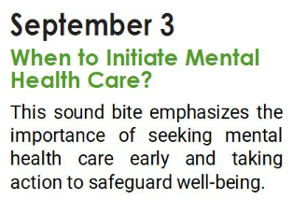
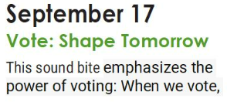
September Sound Bites

Slide 38
Liaison Action Items
Be sure to fill out the Google Form after your breakout session
Take Action!
Think of ways to spread the word about Mental Health within your schools
Voter Registration needs to happen before October 7th

Slide 39
Subcommittee Convene

Slide 40
Subcommittee Convene Discuss Mental Health and You Gaps & Frustration Split by Feeder Pattern Student Led

Slide 41
FORT BEND ISD
16431 Lexington Blvd.
Sugar Land, TX 77479
281-634-1000
www.fortbendisd.com

